Slide 1
PROJ 216 Software Project Concepts
Day 4

Slide 2
Day 4 Agenda
Quiz 1 ( material from Days 1-3)
Objects-Oriented Concepts
Overview of Unified Modeling Language (UML)
Use Cases
Class Diagrams
Workshop: UML Use Case Diagram – due 8 a.m. on Day 5

Slide 3
Thinking of Objects

Slide 4
Classes & Objects
An Object
Is a person, place, or thing, or concept
Has permanence and identity
Well defined boundaries and meaning
Can be simple or complex
Can be real
Example: a Car, a Chair
or imaginary
Example: a Color, a Date
http://www.developer.com/java/other/article.php/3347291/Thinking-in-Objects.htm

Slide 5
Classes & Objects
Objects have:
Attributes
Properties
“what object has”
Operations
behaviours
Methods
“what object does”, or what is done to it
Examples?

Slide 6
Classes & Objects
A Class
A set of objects sharing a common structure and common behaviour
An object is an instance of a class
Blueprint, or template, for creating objects
The terms “instance” and “object” are used interchangeably

Slide 7
Identifying Classes
Similar to entity/relationship identification
Get a written description of a situation
Identify the nouns or noun phrases
These might indicate classes of objects
Testing if an item is an candidate of a class:
Relevance to the problem domain
Can exist independently
Has attributes and operations

Slide 8
Class Exercise
Working in your project groups, identify 4 or 5 classes in the travel agency project
After 20 minutes we will compare the results

Slide 9
Interface & Implementation
Interface is the outside view
Public – items accessible to all external objects through the interface (porthole)
Implementation is the inner workings
Private – items accessible only from inside the object, hidden from outside (brick wall)

Slide 10
Data Hiding
Typically:
Attributes (properties) are private
Operations (methods) are public
Why?
This is called Data Hiding, or Encapsulation

Slide 11
Group Exercise
In your workshop groups, work with the 4 or 5 classes that you identified in the Travel Experts scenario
For each class, list its properties and operations (the things you need to do to it or with it)
After about 15 minutes we will compare your group findings with the other groups and discuss

Slide 12
Class Relationships
System’s behaviour is accomplished by collaboration of objects
Objects collaborate by calling methods, passing parameters, and receiving returned values
An Association between classes means that an object uses data or methods in another object
Example: car and passenger
More examples?

Slide 13
Class Relationships
Association is the most common type of relationship between classes
Other types of relationships
Aggregation: one object is a part of another object
``has a``
Generalization: one class is a special case of another class
``is a``

Slide 14
Types of Relationships
Aggregation
Whole/part relationship
Container and contents
Can navigate from whole to its parts
Example: JavaScript – document, form and elements
Document
Element
Form
Option

Slide 15
Types of Relationships
Generalization
More general/more specific relationship
Inheritance
More specific class inherits properties and operations of the more general class
More specific class extends more general class

Slide 16
Generalization
form field
text field
button
password field
text area
submit button
reset button

Slide 17
Class Exercise
(10 minutes) In the Travel Agency project, are any of the classes you’ve chosen related by:
Association?
Aggregation?
Generalization?
Compare the findings with other groups

Slide 18
Unified Modeling Language (UML)

Slide 19
Modeling Method
Language (notation)
Process (sequence of tasks)
Tool (software)
http://www.agiledata.org/essays/objectOrientation101.html
http://edn.embarcadero.com/article/31863

Slide 20
History of UML
In the nineties, many different methodologies for software design
Each had own set of notations
Major three:
Behavior Analysis Design
OMT (Rumbaugh) ☹ ☺ ☹
Booch ☹ ☹ ☺
OOSE (Jacobson) ☺ ☹ ☹

Slide 21
History of UML - Continued
1995 – first draft of Unified Method
1997 – UML becomes industry standard for object-oriented modeling
2005 – UML 2.0
https://en.wikipedia.org/wiki/Unified_Modeling_Language#History

Slide 22
Books24X7
Lot of books on UML; these are just samples:
Sams Teach Yourself UML in 24 Hours by Joseph Schmuller ISBN:0672316366
UML Bible by Tom Pender ISBN:0764526049
The Elements of UML Style by Scott W. Ambler ISBN:0521525470

Slide 23
UML Diagrams
Use Case Model – captures user’s perspective
Use case diagrams
Logical Model
Structure of the system
Class diagrams, package diagrams
Behaviour of the system
Sequence diagrams, communication diagrams, state transition diagrams, activity diagrams
Physical Model
Component diagram (software)
Deployment diagram (hardware)

Slide 24
Use Case Diagrams
Use Case diagrams
Identifies who interacts with the system - actors
Identifies major parts of system’s functionality - use cases

Slide 25
Logical Model (Structure of the System)
Describes static structure of the system
Classes
Attributes
Operations
Relationships
Class diagrams
Packages
Package diagrams

Slide 26
Physical Model
Describes physical implementation of the system
Component Diagrams (software)
Deployment Diagram (hardware)

Slide 27
Use Case Analysis
Use cases are top-level items of system’s functionality from the users’ point of view
Two components of documenting use cases:
Written use case descriptions
Use case diagram
Shows interaction between users and the system in very general terms
No detailed steps
No timing consideration

Slide 28
Use Case Description
No standard format
Typical elements:
Use case name (verb-noun phrase)
Who interacts with it (actors)
What triggers it
Normal flow of events
Subflows (break it down to simplified description)
Exceptional flows
http://pmblog.accompa.com/2009/10/08/use-case-template-example-requirements-management-basics/

Slide 29
Use Case Diagrams
Use cases – major pieces of system’s functionality, as observed by the users
Within system’s boundary
Labeled with verb-noun phrase
Actors – people (roles) or other systems that interact with our system
Derives benefit from the system
Is external to the system

Slide 30
Use Case Diagrams - Relationships
Association
Links an actor to the use case(s) with which it interacts
Relationships between two use cases
Include
Extend
Generalization
Relationships between two actors do not exist (irrelevant – outside of the system)

Slide 31
Example: e-Commerce Website
Optional
Process payment is a MANDATORY part of use case Buy Products

Slide 32
Use Case Diagrams
More complex example of a use case diagram:
http://www.agilemodeling.com/artifacts/useCaseDiagram.htm

Slide 33
Case: Campus Housing Service
Campus Housing Service helps students find apartments
Apartment owners fill in information forms about the rental units they have available (location, number of bedrooms, monthly rent)
Students can search through this database via the Web to find apartments that meet their needs. They then contact the apartment owner directly to see the apartment and possibly rent it
Apartment owners call the service to delete their listing when they have rented the apartment
Group Exercise (20 minutes)
Create a Use Case Diagram for Campus Housing Service

Slide 34
Contact with owner
Rent apartment
extend
include
Search apt
Student
Fill Location
include
List
apt
Fill Form
Fill no of rooms
include
Owner
include
Fill rent
Call service
include
Service Staff
Delete list

Slide 35
Search apt
Student
List
apt
Owner
Delete list
Service Staff

Slide 36
Classes
Finding and documenting classes
Informal descriptions
identify nouns (objects) and verbs (operations) in written problem description
CRC cards
Structured analysis
model the problem - dataflow diagrams, etc.
analyze data elements for potential objects

Slide 37
Class Diagrams
Symbols
Class
Association
Cardinality
Association Class
Aggregation
Generalization
http://www.ibm.com/developerworks/rational/library/content/RationalEdge/sep04/bell/

Slide 38
Class Diagrams
Employee
firstName
lastName
address
city
province
postalCode
grossPay
calculatePay(double)
printMailingLabel() : String

Slide 39
Class Diagrams
Start small and simple: smaller and simpler model is easier to understand; also it is easier to add things to the model that to remove
Expect the class diagram to change over time as you will discover the need for more classes, or more detail (operations and/or attributes) in existing classes

Slide 40
Association Relationship
Cardinality
How many of one object are related to how many of another object
One-to-one
Sale transaction to credit card payment
One-to-many
sale to product-sold
Many-to-many
customer to salesperson
Roles – describe role each class plays in the association

Slide 41
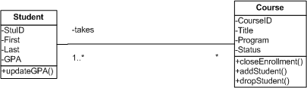
Association Example

Slide 42
Cardinality Exercise
Indicate cardinalities at each end of the following relationships:
A patient must be assigned to only one doctor, and a doctor can have many patients
An employee has one phone extension, and a unique phone extension is assigned to each employee
A movie theatre show many different movies, and the same movie can be shown at different theatres around town
Patient
Is assigned to
Doctor
one-many
0..*
1
Employee
Is assigned
Phone Ext
one-one
1
1
Movie
Is shown at
Theater
many-many
0..*
0..*

Slide 43
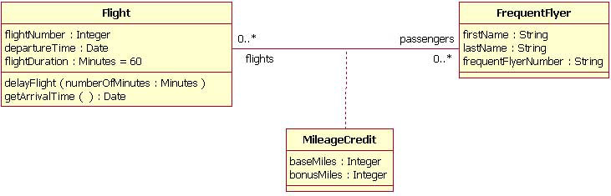
Association Class
When there is a need to store data for the relationship itself
Useful particularly in many-to-many relationships
Can be replaced with additional class and two relationships
http://www.ibm.com/developerworks/rational/library/content/RationalEdge/sep04/bell/

Slide 44
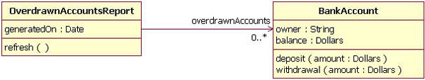
Unidirectional Association
When two classes are related, but only one class “knows” about the relationship – add an arrow to the line
This is rare
http://www.ibm.com/developerworks/rational/library/content/RationalEdge/sep04/bell/

Slide 45
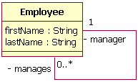
Reflexive Association
One object of the class is related to other objects of the same class
Again: rare
http://www.ibm.com/developerworks/rational/library/content/RationalEdge/sep04/bell/

Slide 46
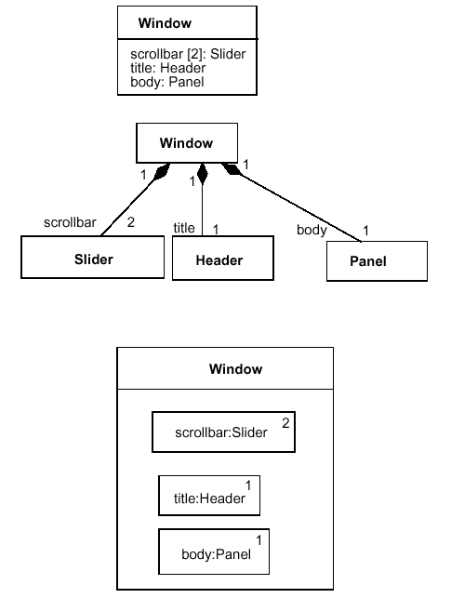
Aggregation

Slide 47
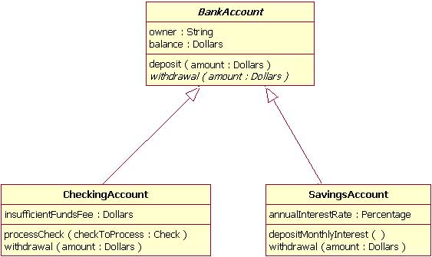
Generalization Example

Slide 48
UML Use Case Diagram Assignment
Working in Travel Experts project groups, create:
Use case diagram that shows use cases, actors, and their relationships
DUE DATE: 8:00 a.m. on Day 5
Create one copy of each diagram per group, but each student submits through learn.sait.ca

